Slide 1

ev charging analytics
MY SQL PROJECT

Slide 2

#1. Create a database named EV_Charging_Analytics.
QUERY: create database EV_charging_analytics;
use EV_charging_analytics;
OUTPUT:

Slide 3
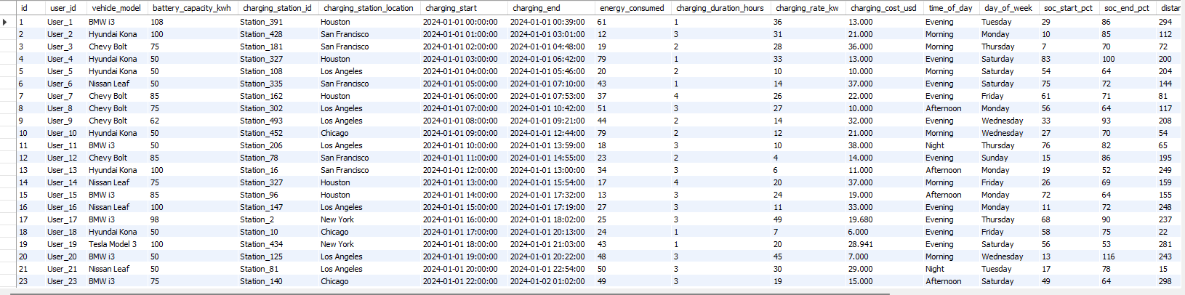
#2. Create a table ev_charging_sessions with appropriate data types and constraints.
QUERY: create table EV_charging_pattern (id int,user_id varchar(20),vehicle_model varchar(20),battery_capacity_kwh int,charging_station_id varchar(20),charging_station_location char(20),charging_start datetime,charging_end datetime,energy_consumed int,charging_duration_hours int,charging_rate_kw int,charging_cost_usd int,time_of_day char(20),day_of_week char(20),soc_start_pct int,soc_end_pct int,distance_km int,temperature_c int,vehicle_age_years int,charger_type varchar(20),user_type varchar(50));select * from EV_charging_pattern;
OUTPUT:

Slide 4
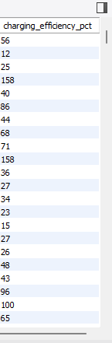
#3. Add a new colum charging_efficiency_pct.
QUERY: alter table EV_charging_pattern add column charging_efficiency_pct int;
OUTPUT:

Slide 5
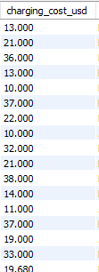
#4. Modify charging_cost_usd to increase precision.
QUERY: alter table EV_charging_pattern modify charging_cost_usd decimal(10,3);
OUTPUT:

Slide 6
#6. Import all records from CSV file.
#5. Drop temperature_c column.
QUERY: alter table EV_charging_pattern drop temperature_c;
OUTPUT: ALREADY DROP THEB TABLE

Slide 7
#7. Update charging_efficiency_pct = (energy_consumed / battery_capacity_kwh) * 100.
QUERY: update EV_charging_pattern set charging_efficiency_pct = (energy_consumed / battery_capacity_kwh) * 100;
OUTPUT:

Slide 8
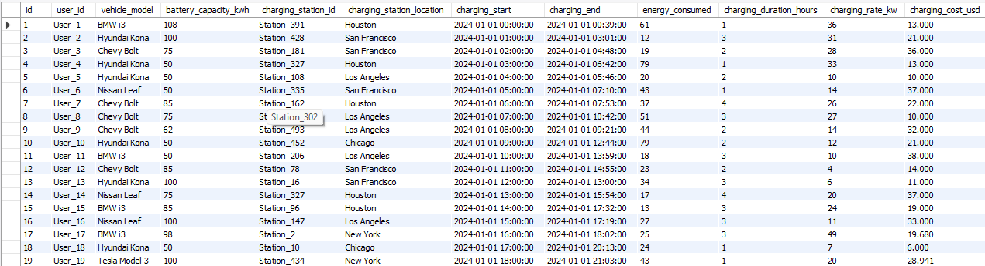
#8. Increase charging_cost_usd by 5% for New York.
QUERY: update EV_charging_pattern set charging_cost_usd = charging_cost_usd * 1.05 where charging_station_location = 'new york’;
OUTPUT:

Slide 9
#9.Delete records where energy_consumed < 5.
QUERY: delete from EV_charging_pattern where energy_consumed < 5;
OUTPUT:

Slide 10
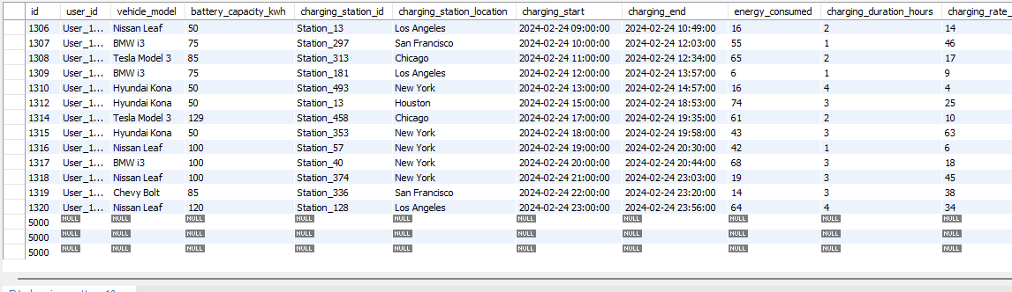
#10. Insert a test record manually.
QUERY: insert into EV_charging_pattern (id) values (5000);
OUTPUT:

Slide 11
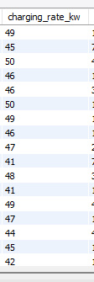
#11. Retrieve sessions where charging_rate_kw > 40.
QUERY: select * from ev_charging_pattern where charging_rate_kw > 40;
OUTPUT:

Slide 12
#12. Display top 5 most expensive sessions.
QUERY:select * from EV_charging_pattern order by charging_cost_usd desc limit 5;
OUTPUT:

Slide 13
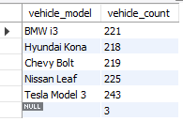
#13. Show distinct vehicle_model names and counts.
QUERY: select vehicle_model,count(*) as vehicle_count from EV_charging_pattern group by vehicle_model;
OUTPUT:

Slide 14
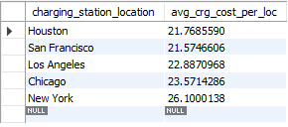
#14. Find average charging cost per location.
QUERY: select charging_station_location,avg(charging_cost_usd) as avg_crg_cost_per_loc from EV_charging_pattern group by charging_station_location;
OUTPUT:

Slide 15
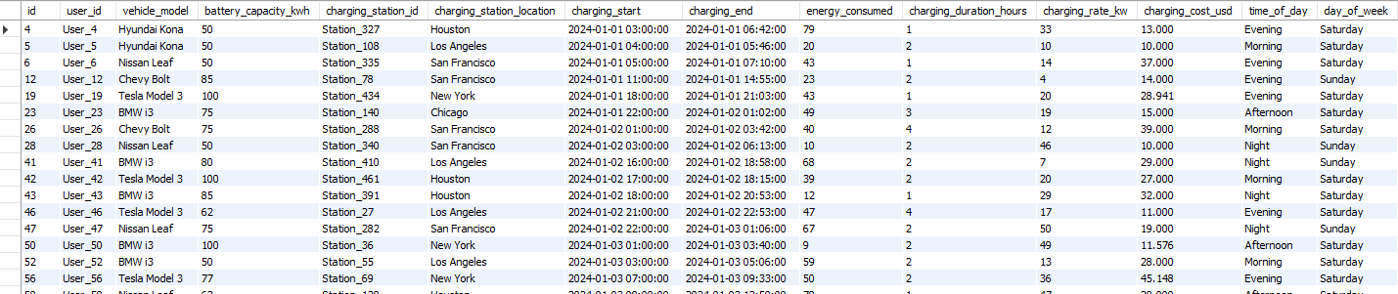
#15. List sessions on weekends.
QUERY: select * from EV_charging_pattern where day_of_week in ('saturday','sunday’);
OUTPUT:

Slide 16

#16. Retrieve sessions where soc_end_pct soc_start_pct > 40.
QUERY: select * from EV_charging_pattern where soc_start_pct > 40;
OUTPUT:

Slide 17

#17. Show average energy and duration per charger_type.
QUERY: select charger_type,avg(energy_consumed) as avg_energy,avg(charging_duration_hours) as avg_duration from EV_charging_pattern group by charger_type;
OUTPUT:

Slide 18
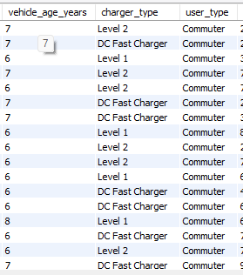
#19. Display sessions with vehicle_age_years > 5 and user_type = 'Commuter'.
QUERY: select*from EV_charging_pattern where vehicle_age_years > 5 and user_type = 'commuter’;
OUTPUT:

Slide 19

#20. Categorize sessions as 'Low', 'Medium', 'High Energy' using CASE WHEN.
QUERY: select *,
case when energy_consumed <40 then "low“
when energy_consumed >85 then "high“
else "medium"end as enrg_con_range
from EV_charging_pattern;
OUTPUT:

